Slide 1
Multimedia Systems Lecture – 21
By
Dr. Priyambada Subudhi
Assistant Professor
IIIT Sri City

Slide 2
Multimedia Data Compression
The amount of digital media data that is produced in the form of text, video, audio, 3D graphics, and combinations of these media types is extraordinarily large, and the rate of creation increases every day.
This growing mass of data needs to be stored, accessed, and delivered to a multitude of clients over digital networks, which have varying bandwidths.
The existence of voluminous data, from creation to storage and delivery, motivates the need for compression.
The role played in multimedia by data compression, perhaps the most important enabling technology that makes modern multimedia systems possible.

Slide 3
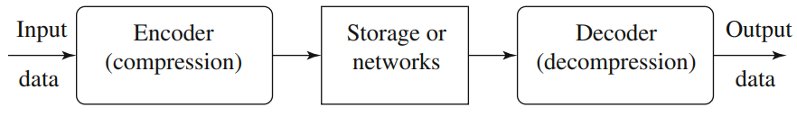
In a general data compression scheme, in which compression is performed by an encoder and decompression is performed by a decoder. general data compression scheme.
We call the output of the encoder codes or codewords.
The intermediate medium could either be data storage or a communication /computer network.
If the compression and decompression processes induce no information loss, the compression scheme is lossless; otherwise, it is lossy.

Slide 4

Compression Ratio: If the total number of bits required to represent the data before compression is B0 and the total number of bits required to represent the data after compression is B1, then we define the compression ratio as
In general, we would desire any codec (encoder/decoder scheme) to have a compression ratio much larger than 1.0.
The higher the compression ratio, the better the lossless compression scheme, as long as it is computationally feasible.

Slide 5
Basics of Information Theory
When transmitting information from a source to a destination, information theory concerns itself with the efficiency and reliability of the transmission.
Information theory allows us to describe the process to compress data without losing its information content.
The data could represent virtually anything— simple text, documents, images, graphics, and even binary executables.
Here we will consider all these varied data types as generic data represented digitally in a binary form by a sequence of 1s and 0s.

Slide 6
To understand compression, it is necessary to understand the information content of a message.
Information relates to the organization in the data as a sequence of symbols. If the sequence changes, so does the information.
For example, you might have a binary data stream that consists of 80,000 bits. These bits might not need to be treated individually, but might instead be grouped into symbols. For instance, if it is known that bits represent a gray-intensity image with each pixel represented by 8 bits, then we have 10,000 pixels or symbols. Furthermore, if width and height of the image are both 100, the bit stream might be interpreted as a gray image of size 100 × 100. Here, each symbol is represented by 8 bits, and there can be 2⁸ = 256 different possible gray levels or symbols.
Also, the arrangement of the symbols is important

Slide 7
Alphabet and Symbol: Information can be thought of as an organization of individual elements called symbols.
An alphabet is defined as a distinct and nonempty set of symbols.
The number or length of symbols in the set is known as the vocabulary.
We can define an alphabet of symbols as S = {s1, s2, s3, s4 . . . sn}. Though n can be very large, in practice, an alphabet is limited and finite and, hence, has a well-defined vocabulary.
In the previous example involving a gray image, each pixel is represented by 8 bits and can have one of 2⁸ or 256 unique values. Here, vocabulary consists of 256 symbols, where each symbol is represented or coded by 8 bits.
Sequence: A series of symbols of a given alphabet form a sequence. For the alphabet {s1, s2, s3, s4}, a sample sequence is s1 s2 s1 s2 s2 s2 s1 s2 s3 s4 s1 s2 s3.
A sequence of symbols is also termed a message produced by the source using the alphabet, and represents information.
When looking at a sequence, some symbols might occur more commonly than other symbols. The frequency of occurrence of a symbol is an important factor when coding information represented by the symbols. The frequency is also known as probability.

Slide 8

Symbol Probability: The probability of occurrence of a symbol is defined by the ratio of the number of occurrences of that symbol over the length of the entire message.
where m_{i} is the number of times symbol s_{i} occurs in the message of length N.
Most coding algorithms make extensive use of symbol probabilities to obtain optimal codes for compression.

Slide 9

Entropy: Shannon’s information theory borrows the definition of entropy from physics to quantify the amount of information contained in a message of symbols given their probabilities of occurrence.
For source-producing symbols, where each symbol i has a probability distribution P_{i} , the entropy is defined as
For the symbol s_{i} having a probability P_{i} , Shannon defined the notion of self-information of the symbol given by log₂(1/P_{i}).
The self-information represents number of bits of information contained in the symbol and, hence, the number of bits used to send that message.
Entropy, then, becomes the weighted average of the information carried by each symbol and, hence, the average symbol length.

Slide 10
For example, if the probability of having the character n in a manuscript is 1/32, the amount of information associated with receiving this character is 5 bits.
In other words, a character string nnn will require 15 bits to code.
The definition of entropy is aimed at identifying often-occurring symbols in the datastream as good candidates for short codewords in the compressed bitstream.
We use a variable-length coding scheme for entropy coding— frequently occurring symbols are given codes that are quickly transmitted, while infrequently occurring ones are given longer codes.

Slide 11

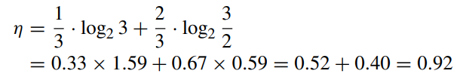
if the information source S is a gray-level digital image, each si is a gray-level intensity ranging from 0 to (2k − 1), where k is the number of bits used to represent each pixel in an uncompressed image. The range is often [0, 255], since 8 bits are typically used.
Fig. a shows the histogram of an image with uniform distribution of gray-level intensities—that is, ∀i p_{i} = 1/256. Hence, the entropy of this image is
Fig. b shows the histogram of another image, in which 1/3 of the pixels are rather dark and 2/3 of them are rather bright. The entropy of this image is
The entropy is greater when the probability distribution is flat and smaller when it is more peaked

Slide 12
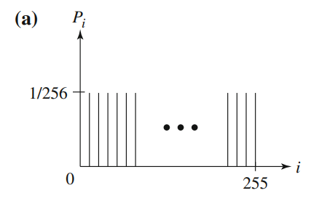
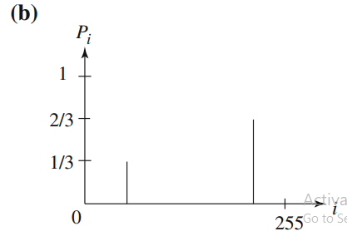
Histograms for two gray-level images. a Uniform distribution; b A sample binary image

